Slide 1
Technical Walkthrough: FCY Payment Processor
Go | PostgresSQL | Docker March 19, 2026
Paul O. Afolabi
Software Engineer

Slide 2
Problem Framing
Build a multi-currency processor for internal and external transfers.
The processor should guarantee correctness of balances, postings, and auditable transaction trail.
Prioritize pragmatic production judgment under time constraints.
Tech stack: Go, PostgreSQL, Docker Compose.

Slide 3
Solution Architecture
Clean Architecture + Repository Pattern was adopted as a suitable design pattern for the solution.
HTTP Adapters → Use Cases (IService) → IRepository → Repository Implementations → PostgreSQL
Dependency inversion implementation to separate high-level logic from low level implementation.
This structure improves testability, maintainability, and safe evolution of the payment system.

Slide 4
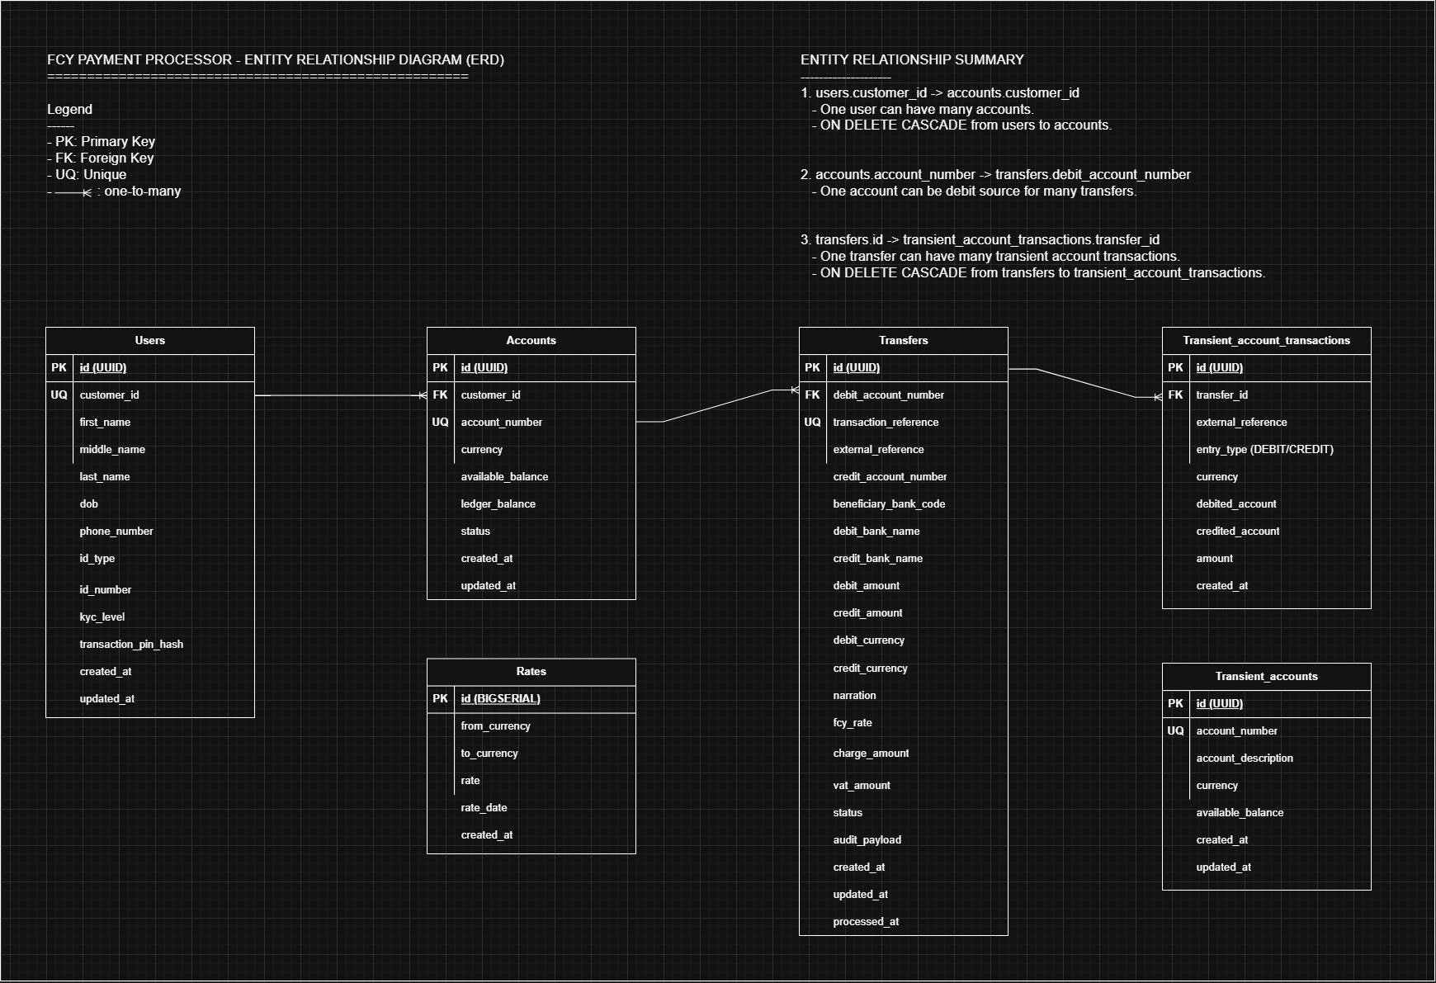
Solution Architecture – ERD, Domain and Data Model

Slide 5
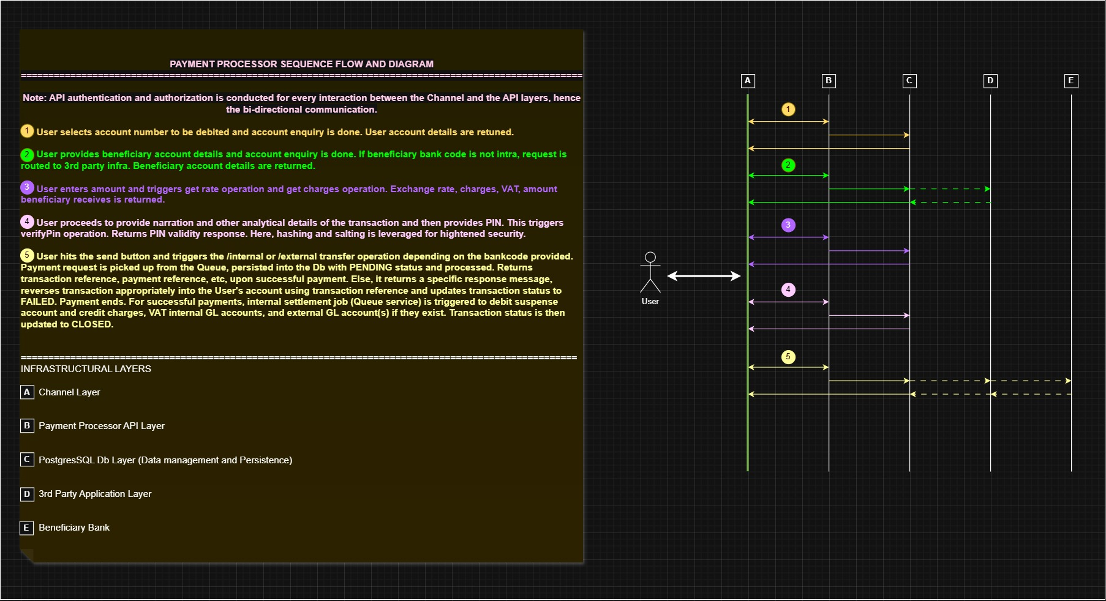
Solution Architecture – Sequence Diagram

Slide 6
API Endpoints
POST /create-user – Creates a customer record. Generates and returns customerId
POST /create-account – Creates FCY account using the customerId generated
GET /get-account – Fetches provided account details if it exists
POST /deposit-funds – Deposits funds for internal, sender account
GET /get-participant-banks – Fetches external banks’ details supported by the payment processor
GET /get-rates – Fetches all maintained currency pairs and rates from the database
POST /get-rate – Fetches specific maintained currency pair and exchange rate
GET /get-charges – Computes and returns detailed charges per amount and currency provided
POST /convert-fcy-amount – Computes amount in sender’s currency relative to beneficiary currency
POST /verify-pin – Verifies user’s transaction PIN
POST /transfer-funds - Debits senders accounts and credits beneficiary’s account. (beneficiaryBankCode=100100 for internal transfers)

Slide 7
Transfer flow - Internal
Validation: Validate request, account states/currencies, and transaction PIN
Computation and Persistence: Compute FX + charges/VAT and persist transfer as PENDING
Posting: debit sender (full amt) => credit GL account (full amt) => debit GL account (txn amt) => credit beneficiary account (txn amt)
Update and Settlement: Status transitions to SUCCESS, then CLOSED after transaction settlement into charges and VAT GL accounts
Response: Transaction details are returned to the user/channel

Slide 8
Transfer flow - External
Routing: Route by beneficiary bank code (non-Grey – 100100 - means external transfer)
Validation: Validate request, account status/currency, transaction PIN, participant bank support and resolve destination external GL by currency
Computation and Persistence: Compute FX + charges/VAT and persist transfer as PENDING
Posting: debit sender (full amt) => credits internal GL account (full amt) => debit internal GL account (txn amt) => credit external GL account of the same currency as beneficiary currency (txn amt)
Update and Settlement: Persist external reference for traceability. Status transitions to SUCCESS, then CLOSED after transaction settlement into charges and VAT GL accounts
Response: Transaction details are returned to the user/channel

Slide 9
Amount Handling, Consistency, Atomicity and Failure Handling
All money math uses decimal.Decimal to accommodate large amount values.
No approximations of figures. I explicitly round initial deposits to 2 decimal places at service level, and monetary persistence (Dr/Cr) uses 2dp DB numeric columns.
Charge computed in USD with min/max bounds; converted to debit currency when needed.
Transaction posting is atomic using DB transaction to improve financial reliability.
Settlement is decoupled as second leg for resilience and recoverability.

Slide 10
Security, Concurrency, and Operational Readiness
Channel-level Basic Auth middleware with constant-time credential compare.
Transaction PIN hashed with bcrypt and verified before transfer.
Structured logging and startup/transfer timing instrumentation.
DB connection pool tuned for concurrent workloads.
Leveraged goroutines for parallel account lookups, charge/rate computations, and startup initialization to reduce latency and improve throughput.

Slide 11
Testing Strategy
Service-focused unit tests with validation and happy-path coverage.
Core test packages currently pass (14 tests total).
Strong focus on business-rule correctness over broad integration depth.

Slide 12
Trade-offs and Risks
Current architecture optimizes delivery speed, maintainability, and financial correctness over deep integration tests and production hardened security. Next phase strengthens security, reliability, and scalability.
Known gaps:
Transfers idempotency implementation
Richer auth model
Deeper observability
Asynchronous queue ingestion
Worker-based settlement

Slide 13
Optimization Strategy
Reliability: Enforce transfer uniqueness with a channel-provided idempotency reference. Reuse the same reference for safe retries, reversals, and downstream audit traceability.
Security: Strengthen auth with API gateway controls (API keys, rate limits, geo/IP filtering), JWT claims for initiator context and authorization, and a dedicated channel-auth service.
Scalability: Introduce Pub/Sub buffering for peak traffic and async transaction processing using either of Apache Kafka, RabbitMQ, GCP Pub/Sub, or AWS SQS.
Monitoring and Operations: Improve observability with OpenTelemetry traces, Prometheus metrics, and Grafana dashboards.
Worker-based settlement: Move fee settlement to asynchronous workers that consume queued transfer events, enabling retries, better fault isolation, and higher throughput under load.

Slide 14
Closing
Built a reliable foundation for multi-currency internal and external transfers with auditable posting flows.
Prioritized financial correctness and delivery speed under time constraints.
Designed for maintainability through clean layering and repository boundaries.
Next phase focuses on security, reliability, and scale: idempotency, async worker-based settlement, stronger auth, and deeper observability.

